Slide 1
Software Engineering and Ontological Engineering: Contributions, Perspectives, Challenges and Learned Lessons
Marcelo José Siqueira C. de Almeida
mjsca@cin.ufpe.br

Slide 2
Summary
Introduction
Motivation
SE and OE… close or too far away?
Scenario
Collaborations
Basic Definitions
Context
Software Engineering
Knowledge Engineering
Ontological Engineering

Slide 3
Summary
Similarities and Differences between SE and OE
Reflection
Open Issues
Contributions of SE for OE
Contributions of OE for SE
The Big Picture
Conclusions
References

Slide 4
Introduction
With the advent of Semantic Web, ontologies have gained interest from the mainstream of Computer Science in the development of different kinds of applications:
Knowledge Management
Natural Language Processing
E-Commerce
Intelligent Integration of Information
Information Retrieval
Data Base Integration and Project
Computer Network and Distributed System Management

Slide 5
Motivation
Growing demands for ontologies push the community of ontology developers and researchers to apply systematic engineering approaches.
Important themes:
Reuse
Quality
Market
Standards

Slide 6
SE and OE: close… or too far away??
Despite of sharing a certain quantity of topics, Software Engineering (SE) and Ontological Engineering (OE) communities have been working separately.
Is there room for effort integration?
What are the learned lessons?
How can each part profit from this union?

Slide 7
Scenario 1
Apply SE for Ontology development
(lifecycle, metrics, modeling languages, etc.)
Ontological Engineering

Slide 8
Scenario 2
Adoption of Ontologies to
improve the SE processes
(support during the lifecycle, execution infra-structure)
(Ontology Based)
Software Engineering

Slide 9
Collaborations
Ontologies
Software
Engineering
May support the
Development of
new SE approaches
Inspirations for the OE
development and
maturing

Slide 10
Basic Definitions
According to (IEEE 1990):
Technique: a technical and managerial procedure used to achieve a given objective.
Method: a set of orderly processes or procedures used in the engineering of a product or performing a service.
Methodology: a comprehensive, integrated series of techniques or methods creating a general theory of how a class of thought-intensive work ought be performed.

Slide 11
Context
OE
KE
SE
AI

Slide 12
Software Engineering
SE is the application of a systematic, disciplined, quantifiable approach to the development, operation, and maintenance of software (Abran and Moore 2004).
Mimic of traditional engineering to cope with the software complexities.
SE pushed the efforts from low-level programming to high-level modeling efforts.
Today SE is a reputed discipline for the market (gradual – and slow - process).

Slide 13
Software Engineering
Standardizations
OMG (Object Management Group)
JCP (Java Community Process)
SWEBOK (Software Engineering Body Of Knowledge – IEEE/COMSOC)

Slide 14
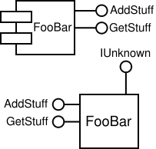
Software Engineering
Component-Based Development
A higher level of abstraction than objects and as such they do not share state and communicate by exchanging messages carrying data (Wikipedia).
High level encapsulation of functionalities
DCOM (Microsoft), EJB (Sun), XPCOM (Mozilla), etc.
Main Benefit: Reusability
Cheaper
Faster
Simpler
Less errors
documented

Slide 15
Software Engineering
Methodologies
RUP (Rational Development Process) (IBM 2008)
It is a comprehensive process framework that provides industry-tested practices for software and systems delivery and implementation and effective project management.
It is based on sound software engineering principles such as taking an iterative, requirements driven, and architecture-centric approach to software development (Kruchten 2004)
Object Oriented and/or component based development
UML documentation

Slide 16
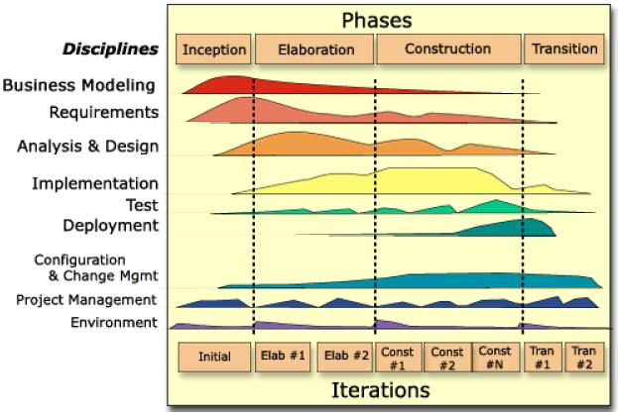
Software Engineering
Notes:
RUP promotes iterative development and organizes the development of software and systems into four phases, each one consisting of one or more executable iterations of the software at that stage of development.

Slide 17
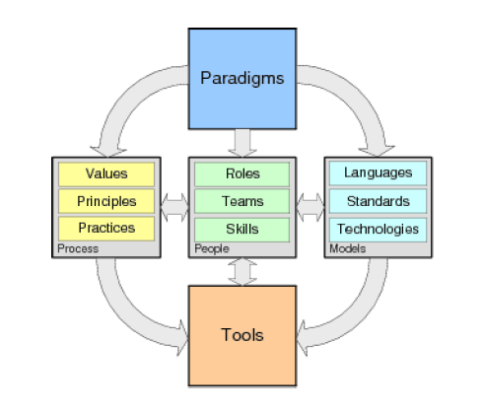
Software Engineering
Agile Methods
Agile Manifesto
Requirements never stop to change
Excessive control freeze the teams
Results faster

Slide 18
Software Engineering
Methodologies
XP (eXtreme Programming) (Beck, 2004)
It is an agile method to develop software faster, cheaper and less error-prone
Focus on programming (code available all the time!)
User-centered (user is a stakeholder)
Principles and values
Suited to not well known domains, poorly specified, simple and small problems.
Small teams

Slide 19
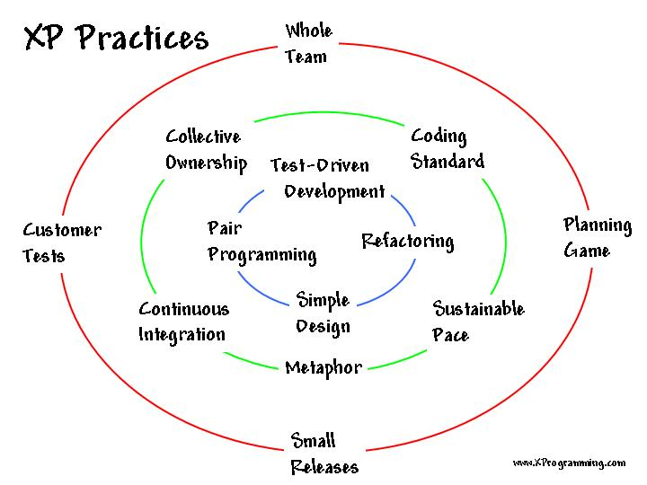
Software Engineering

Slide 20
Software Engineering
Aspect Oriented Programming
Simplify the modularization of common concerns amongst the different modules of an OO application.
Allows separation of Cross-Cutting Concerns.
Example:
Transactions
Real Time restrictions
Fault Recovery
Security
Logging
APIs: AspectJ, Aspect.NET, AspectC++

Slide 21
Software Engineering
Method 1
Method 2
Method 3
Method 1
Method 2
Method 3
Class with Tangled
Funcionalities
Class with Cross Cutting
Concerns

Slide 22
Software Engineering
Fault tolerance
Logging
Multi-Dimensional
View
(cross-cutting concerns)
Persistence

Slide 23
Software Engineering
Quality Management (Koscianski and Soares, 2007)
Aims to completely meet the user requirements:
Time, money, errors, performance, etc.
Main efforts:
CMMI
ISO/IEC 15504
MPS.BR

Slide 24
Software Engineering
CMMI (Capability Maturity Model Integration)
Evaluates if an organization conducts its processes in a mature way in order to obtain better products
Discipline, testing, documentation, quantification, optimization
Integration of existing models:
P-CMM (People)
SA-CMM (Software Acquisition)
SE-CMM (System Engineering)
SW-CMM (Software)
Problem: Complexity

Slide 25
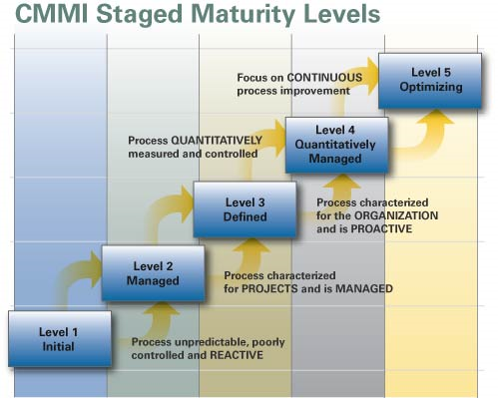
Software Engineering

Slide 26
Software Engineering
ISO/IEC 15504
International standard for software process assessment.
Originated in SPICE (Software Process Improvement and Capability dEtermination)
Project Influenced by CMMI model and ISO/IEC 12207.
Based on two dimensions:
Process: observes the execution of tasks.
Capacity: similar to CMMI.
Needs ISO/IEC 12207 to be executed.
Problem: excessive bureaucracy.

Slide 27
Software Engineering
MPS.BR
Melhoria do Processo de Software Brasileiro
Introduces the SE principles focusing the micro, small and medium organizations according to Brazilian market reality.
CMMI and ISO/IEC 15504 complaint
Finer granularity
Problem: valid only in Brazil

Slide 28
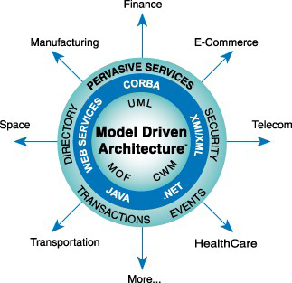
Software Engineering
MDA (Model Driven Architecture)
OMG standard
Model is the most important artifact of the software development
Model Transformation in two phases:
PIM (Plataform Independent Model)
PSM (Plataform Specific Model)
Advantage:
Reduction of time, cost and complexity during the software development and management

Slide 29
Software Engineering
Bussiness
Requirements
Reality
PIM
Plataform
Independent
PSM
PSM
PSM
Plataform
Dependent
Implementation
Implementation
Implementation

Slide 30
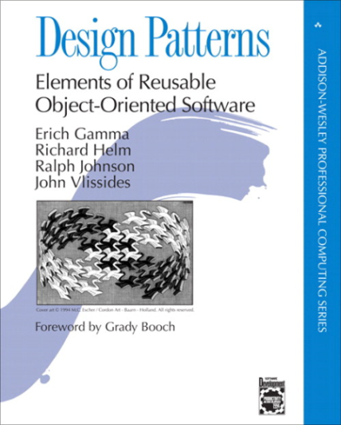
Software Engineering
Patterns
Tested and documented form to reach a objective (Fowler, 2002).
SE community has hardly been looking for reusability in all software life cycle:
Analysis
Design
Coding
Testing
Architectural
Probably the most used ones are the Design Patterns
Classical book:
“Elements of reusable OO SW” (Gamma et al., 1996)
23 patterns
Extensions: JEE, JME, SMAs, etc.

Slide 31
Knowledge Engineering
Regards to the development of expert systems, evolving methodologies and techniques of knowledge representation (Happel and Seedorf, 2007).
It refers to the building, maintaining and development of knowledge-based systems (Kendal, 2007).
Great deal in common with SE, knowledge management, ontologies and conceptual modeling;

Slide 32
Knowledge Engineering
Phases of KE (Allen, 1982; Freitas, 2007)
Knowledge Level
Acquisition
Natural Language
Formalization
Knowledge Representation Language
Logical Level
Implementation Level
Implementation
Programming Language
Refinement
KE
KB

Slide 33
Knowledge Engineering
Methodologies
CommonKADS
TOGA (Top-down Object-based Goal-oriented Approach)

Slide 34
Ontological Engineering
Refers to (Corcho et al., 2006):
the set of activities that concerns the ontology development process;
the ontology life cycle;
the principles, methods and methodologies for building ontologies;
the tool suites and languages that support them.

Slide 35
Ontological Engineering
Principles for constructing ontologies (Gruber, 1993):
Clarity: Effective communication.
Extendibility: Monotonic reasoning.
Coherence: logical soundness.
Minimal Encoding Bias: independence of a particular symbol-level encoding.
Minimal Ontological Commitment: consistent use of a vocabulary.

Slide 36
Ontological Engineering
Methods and methodologies
Cyc (Leena and Guto, 1990)
Its goal was to create a broad knowledge base with general information of common sense.
Specifically developed to an ontology of same name.
TOVE (Grüninger and Fox, 1995)
TOronto Virtual Enterprise (University of Toronto)
Inspiration came from the development of knowledge-based systems using FOL

Slide 37
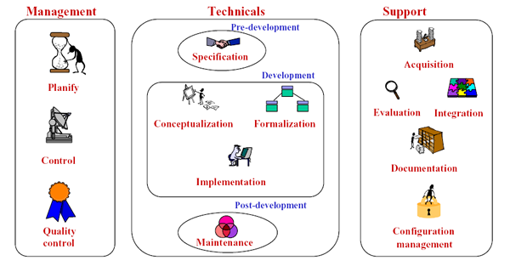
Ontological Engineering
Methontology (Goméz-Pérez et al., 1997)
Build ontologies from scratch, from other existing ones and also support reengineering.
Based on the standardized software development process of IEEE (IEEE 1996) and KE methods.

Slide 38
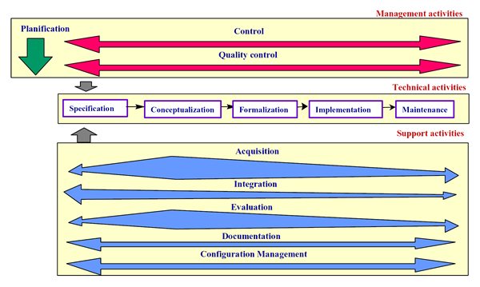
Ontological Engineering
Methontology

Slide 39
Ontological Engineering
101 (Noy and McGuinness, 2001)
Developed in KSL (Knowledge Systems Laboratory) of Stanford University
Interactive and very simple approach
Closer to be a set of guidelines formulated by experienced persons, but far from being a process
Tool-centered (Protégé, Ontolingua and Chimaera)

Slide 40
Ontological Engineering
OntoAgile (Parente, 2008)
Based on the agile methodologies XP and Scrum.
Less documentation and more user interaction
Limitation: Intended to development of small-size ontologies

Slide 41
Ontological Engineering
Construction
Concept Acquisition
Existing Ontologies
Relationship
(Table of Concepts)
Planning Meeting
Delivery Meeting
Integration
Codification
Consistency Verification

Slide 42
Ontological Engineering
RapidOWL (Auer and Herre, 2006)
Based on the idea of iterative refinement, annotation and structuring of a knowledge base.
A central paradigm is the focus on smallest information chunks (RDF chunks).
Influenced by XP.K (eXtremme Programming of Knowledge-based systems) and the wiki approach.

Slide 43
Ontological Engineering
Values
Transparency
Courage
Simplicity
Community
Incremental
Organic
Uniform
Open
Obsevable
Convergent
WYSIWYM
Rapid Feedback
Principles
Simple KM
Interactive Cooperation
Modeling Standards
Joint Ont Design
View Generation
Cons. Checking
Ont .Evol.
Short Releases
Communit Modeling
Information Integration
Practices

Slide 44
Ontological Engineering
Tools (Corcho et al., 2006)
Specific Language Ontology Environments
Ontolingua Server (Ontolingua and KIF)
OntoSaurus (Loom)
WebOnto(OCML)
OilEd (OIL and DAML+OIL)
SWOOP and KAON2 (OWL)

Slide 45
Ontological Engineering
Tools (cont.)
Language Independent Integrated Environments
Protégé
WebODE
OntoEdit
KAON1

Slide 46
Ontological Engineering
State of Art
Modularization
Requirements Traceability
Development Patterns

Slide 47
Ontological Engineering
Modularization (Spaccapietra et al., 2005)
The main aim is to provide scalability in design, use and maintenance of ontologies (Stuckenschimidt and Klein, 2003)
Distributed ontologies
Large Ontologies
Reusability
Ontology composition and decomposition

Slide 48
Ontological Engineering
Module 1
Resultant Ontology
Module 2
Module 3

Slide 49
Ontological Engineering
Alignment
Process of determining correspondences among concepts (Euzenat, 2004)
Distinct vocabularies and structures
Ontology 1
Ontology 2
<C1, R1,I1, A1>
<C2, R2,I2, A2>
Car
Vehicle
+
=
?

Slide 50
Ontological Engineering
Development Patterns (Blomqvist, 2007; Gangemi, 200?)
Patterns have been successfully applied as a means for facilitating reuse and managing complexity in many areas.
Reusability has gained increasing interest by the ontology community
Complexity is a serious problem in the management of ontologies.

Slide 51
Ontological Engineering
Proposal of a Pattern Classification(Blomqvist and Sandkuhl, 2007):
Application Patterns
Architecture Patterns
Design Patterns
Semantic Patterns
Syntactic Patterns

Slide 52
Similarities between SE and OE
Historical contexts
Necessity for systematic approaches in order to obtain better, cheaper and quickly developed products .
Development based on a well defined set of steps:
Viability, specification, analysis, implementation, integration, tests, etc.
Reusability as a driving force

Slide 53
Differences between SE and OE
The result of SE is a running software and the result of an OE is an ontology.
SE community is very concerned to quality questions.
SE is a very mature discipline, but OE is still in its early years.

Slide 54
Differences between SE and OE
Topic | SE | OE
Modularization | Mature | State of Art
Documentation | Mature | Still Amateur
Standardization Efforts | Good (despite of chaos) | Inexistent
Tools | Big diversity | Good evolution
Patterns | Mature | Beginning
Quality Assessment | Process and Product | Product (Early steps)
Methodology | Good acceptance | Little acceptance
Multidimensional Modeling | Yes | No
Heavy Weight Methodologies | RUP, Clean Room, OpenUP | Methontology, TOVE, Cyc
Light Weight Methodologies | XP, Scrum, Crystal | OntoAgile, RapidOWL

Slide 55
Reflections
Why not simply to apply Software Engineering methodologies to ontology development?
Ontologies are software…
…But ontologies aren’t applications!
Knowledge and semantic requirements
Lack of competence from the SE community to deal with KBS
Application
Ontology
Data

Slide 56
Reflections
Is OE just a branch of SE?
Ontologies as a software artifact
Will the traditional SE approaches really adopt OE or are we just surfing in a hype?
OE
SE

Slide 57
Conclusions
The AI community has given an important step forward into the market:
Necessity to develop an Engineering approach.
Knowledge-Based Systems for the masses (?)
OE and SE communities have benefited mutually
Benefits could be broader if efforts could be integrated in common projects.
Market developers woke up to ontology power but there is still a long way to walk away to achieve a large adoption.
Despite all OE advance there are many gaps yet!
Standardization
Component-based development
Quality assessment

Slide 58
Conclusions
No existing methodology approaches the recent advances in OE.
The real understanding of differences and similarities between OE and SE must comes with the understanding of differences and similarities between ontologies and software applications.
Maybe in the future there won´t be a line between them:
Semantic web as a development platform similar to what happens today in Web 1.0 and Web 2.0.

Slide 59
References
Allen (1982), The Knowledge Level,
Abran and Moore (2004),
Auer and Herre (2006),
Beck (2004), Programação Extrema Aplicada, Ed. Bookman, 2004.
Blomquist (2007),
Blomquist and Sandkuhl (2007), Patterns in Ontology Engineering: Classification of Ontology Patterns.
Calero et al. (2006), Ontologies for Software Engineering and Software Technology, Springer, 2006.
Corcho et al. (2006),
Euzenat (2004). An Ontology Alignement API.
Fred (2007), Engenharia do Conhecimento. Notas de Aula. Avaliable on http://www.cin.ufpe.br/. Last Access on 08 october 2008.
Fowler (2002),

Slide 60
References
Gamma et al. (1996), Elements of Reusable Object-Oriented Software, Addison-Wesley, 1996.
Gómez-Pérez et al. (1997),
Goméz-Pérez et. al. (2004), Ontological Engineering, Springer, 2004.
Jörg and eedorf, Applications of Ontologies in Software Engineering,
Kendal, Simon & Creen, Malcolm (2007). An Introduction to Knowledge Engineering. Springer.
IBM, Rational Unified Process, avaliable at http://www-01.ibm.com/software/awdtools/rup/. Last access in 8 october 2008.8

Slide 61
References
Gruber (1993), Towards principles for the design of ontologies used for knowledge sharing. Originally in N. Guarino and R. Poli, (Eds.), International Workshop on Formal Ontology, Padova, Italy. Revised August 1993. Published in International Journal of Human-Computer Studies, Volume 43 , Issue 5-6 Nov./Dec. 1995, Pages: 907-928, special issue on the role of formal ontology in the information technology.
Gruninger and Fox (1995),
Happel and Seedorf (2007),
IEEE (1990),
Kendal (2007),
Kosciansky and Soares (2007),
Leena and Guto (1990)
Natalya F. Noy and Deborah L. McGuinness. Ontology Development 101: A Guide to Creating Your First Ontology. Stanford Knowledge Systems Laboratory Technical Report KSL-01-05 and Stanford Medical Informatics Technical Report SMI-2001-0880, March 2001.

Slide 62
References
Parente (2008),
Pressman (2006), Software Engineering, Mc-Graw Hill, 2006.
Spaccapietra et al. (2005),
Soren Auer and Heinrich Herre. Rapidowl - an agile knowledge engineering methodology. In Irina Virbitskaite and Andrei Voronkov, editors, Ershov Memorial Conference, volume 4378 of Lecture Notes in Computer Science, pages 424–430. Springer, 2006
Stvilia (2008),
Nicola Guarino and Chris Welty, Conceptual Modeling and Ontological Analysis, AAAI-2000 Tutorial on Conceptual Modeling and Ontological Analysis (MP-2). July 31, 2000.
Tempiche and ,
Turnban and Aronson (2008),

